Slide 1


Estimating Missing Data in Temporal Data Streams Using
Multi-directional Recurrent Neural Networks
연구 계획서
고려대학교 산업경영공학과
DAHS 연구실
김홍범
Data Analytics and
Healthcare Systems LAB

Slide 2
CONTENTS
1. Introduction
2. Problem Formulation
3. Multi-directional Recurrent Neural Networks (M-RNN)
4. Results and Discussion
5. Q & A

Slide 3
01
Introduction
01. methods
Estimating missing value methods
Interpolation – within each stream
Imputation – across streams
Matrix completion – within and across streams(ignore temporal aspect)

Slide 4
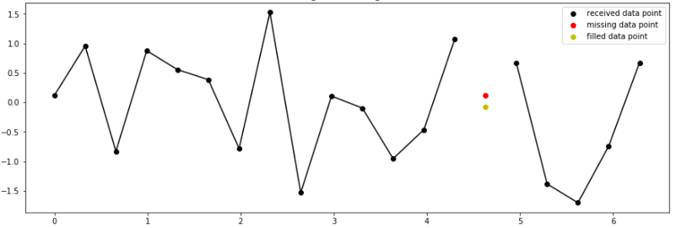
01
Methods
02. Interpolation
Interpolation method
Advantages: Reflects the amount of data changes over time
Disadvantage: Unable to determine association between variables

Slide 5
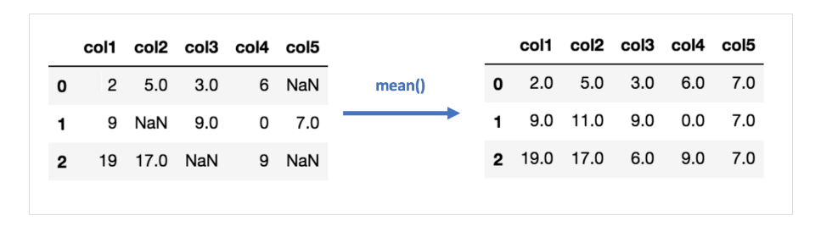
01
Methods
03. Imputation
Imputation method
Advantages: Easy and fast
Disadvantage: It is impossible to identify the time series association. Sensitive to outlier

Slide 6
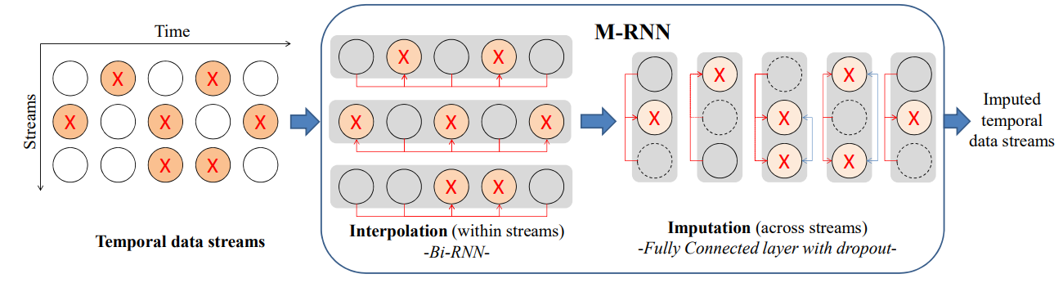
01
Introduction
04. M-RNN
M-RNN
X = missing values, red lines = connections between observed values and missing values in each layer, blue lines = connections between interpolated values, dashed line = dropout

Slide 7

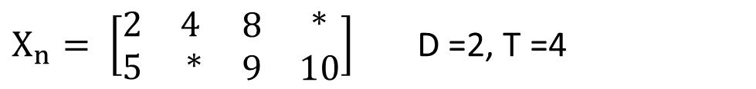
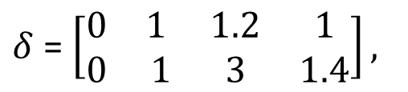
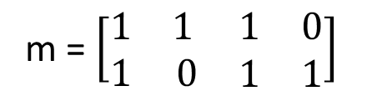

02
Problem Formulation
1. Notation
Datasets notations
Dataset consists of N patients with D Channels and length T
$X_{n}= \left[\begin{matrix}2 & 4 \\ 5 & ∗\end{matrix} \begin{matrix}8 & ∗ \\ 9 & 10\end{matrix}\right]$ D =2, T =4
$x_{t}^{d}=∗$ missing value
Binary mask is defined to mask missing value (1 if data is observed, 0 if missing)
m = $\left[\begin{matrix}1 & 1 \\ 1 & 0\end{matrix} \begin{matrix}1 & 0 \\ 1 & 1\end{matrix}\right]$
Delta to be the actual amount of time that has elapse from $s_{t}(normalized)$, $δ_{1}^{d}=0$, $s_{1}=0$
$δ$ = $\left[\begin{matrix}0 & 1 \\ 0 & 1\end{matrix} \begin{matrix}1.2 & 1 \\ 3 & 1.4\end{matrix}\right],$

Slide 8

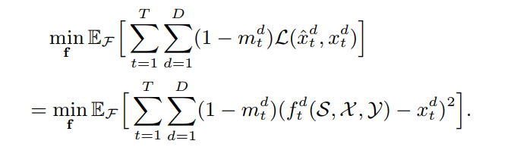

02
Problem Formulation
2. Objective function
Objective function
Also $y_{t}$ represents vector of outcomes for this patients. Such as discharge, death etc. $y_{t}$ =0, 1
The entire dataset consists of all above the patients $D=\{(S\left(n\right),X\left(n\right), y(n)\}$
(Time stamps = S, measurements = X, lables = Y)
Objective function (${\hat{x}}_{t}^{d}=f_{t}^{d}(S, X)$ , )
We do not observe the true data, so we will minimize the empirical loss.

Slide 9
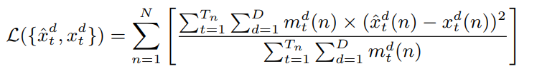
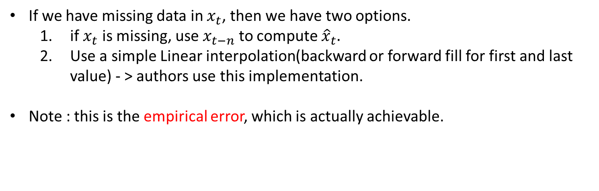
03
Multi-directional Recurrent Neural Networks (M-RNN)
1. Error / loss
Error/Loss
$LOSS\left(total\right)=mean squared error \left(mse\right)=$
If we have missing data in $x_{t}$, then we have two options.
if $x_{t}$ is missing, use $x_{t−n}$ to compute ${\hat{x}}_{t}.$
Use a simple Linear interpolation(backward or forward fill for first and last value) - > authors use this implementation.
Note : this is the empirical error, which is actually achievable.

Slide 10
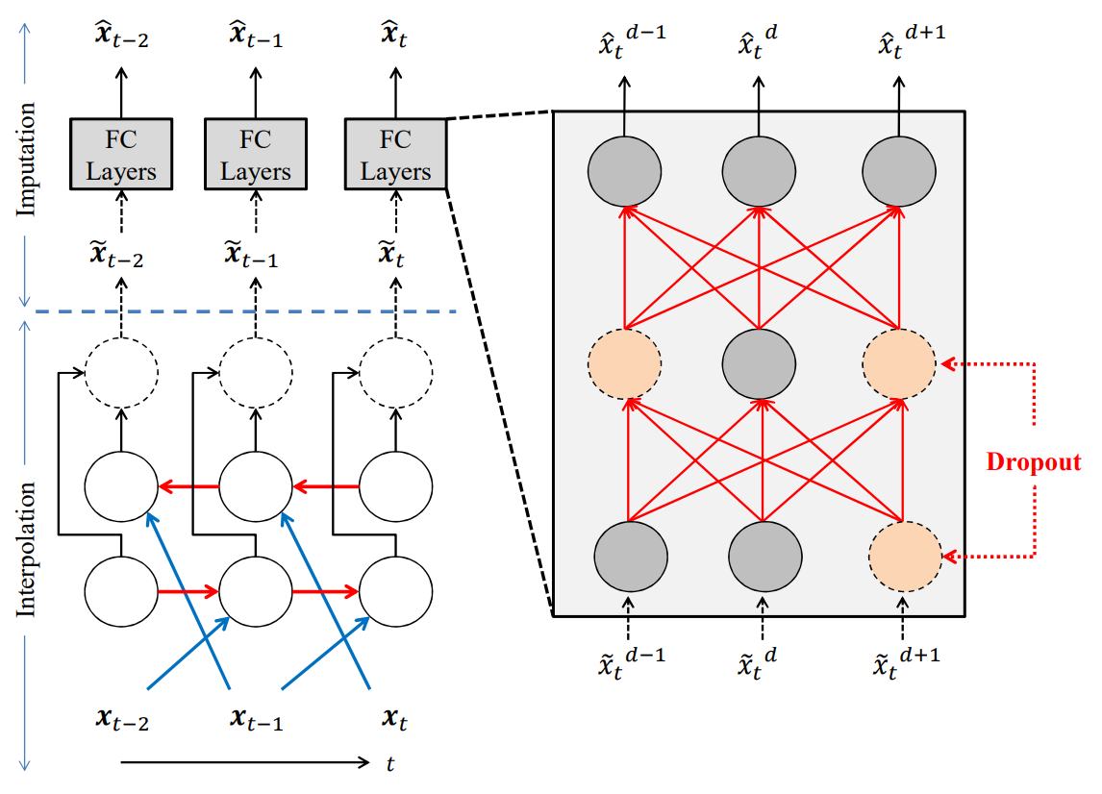
03
Multi-directional Recurrent Neural Networks (M-RNN)
2. M-RNN
M-RNN Architecture

Slide 11
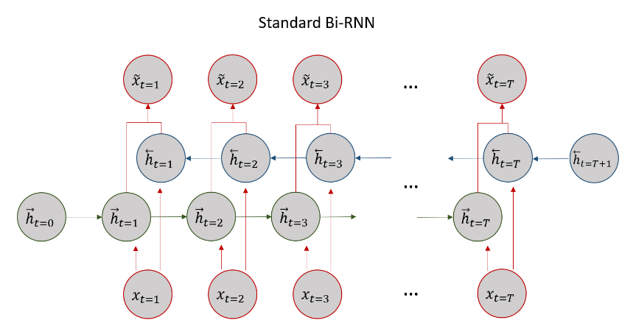
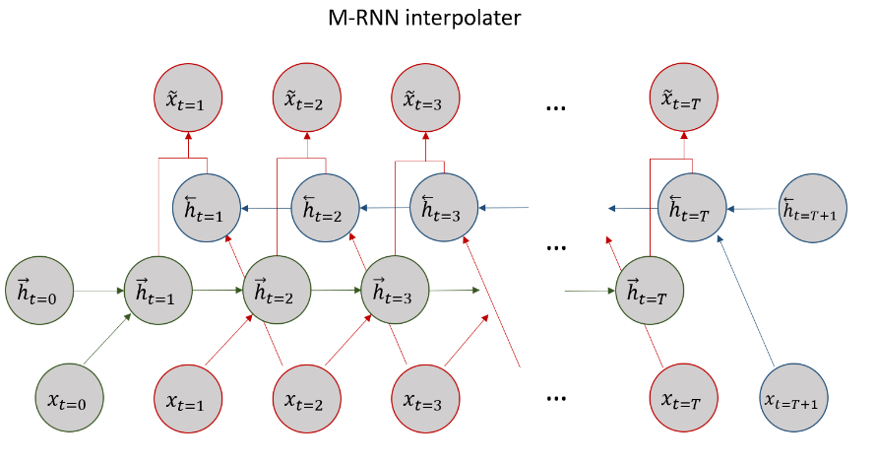
03
Multi-directional Recurrent Neural Networks (M-RNN)
2. M-RNN
M-RNN Interpolator
This procedure ensure that the actual value $x_{t}^{d}$ is automatically not used in the estimation ${\tilde{x}}_{t}^{d}.$

Slide 12
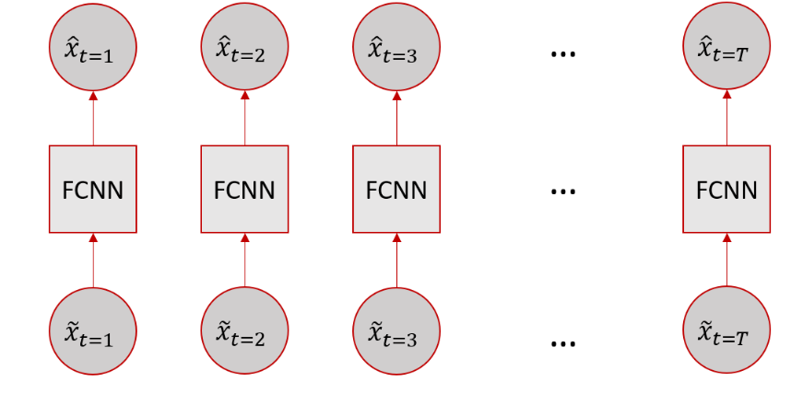
03
Multi-directional Recurrent Neural Networks (M-RNN)
2. M-RNN
M-RNN imputer
Note : Always the same FCNN for each timestap, also we do not use $x_{t}^{d}$ in every step.
In this process, we use dropout process for multiple imputation.

Slide 13
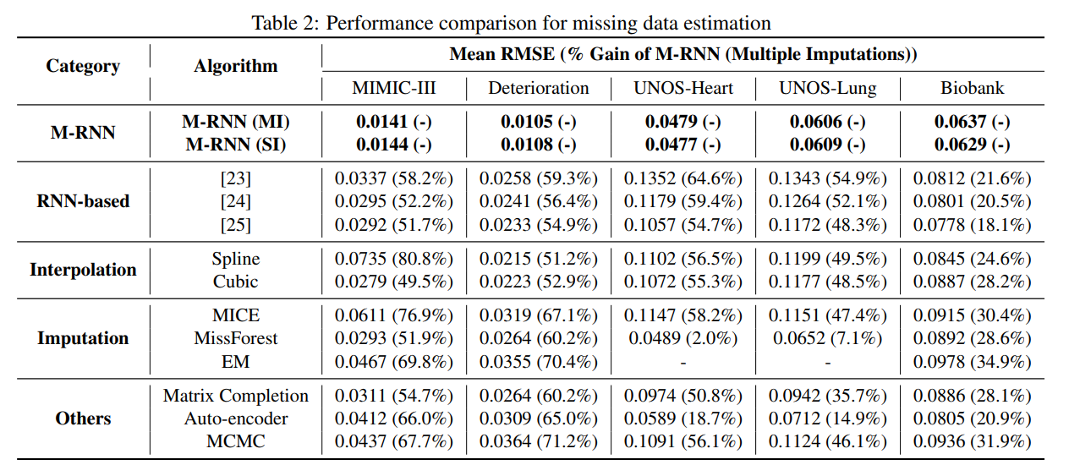
04
Results and Discussions
1. Results
Imputation Accuracy on the Given Datasets

Slide 14
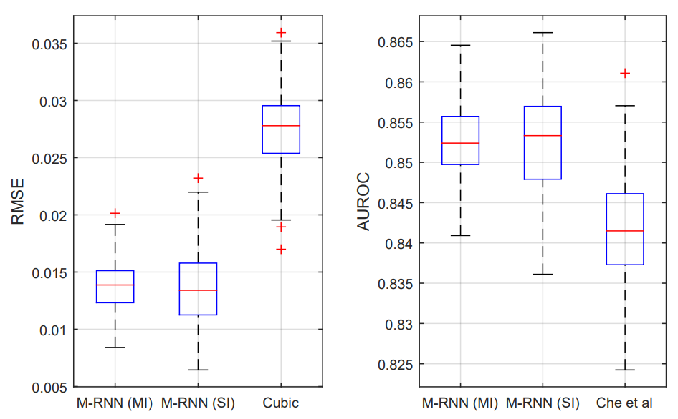
04
Results and Discussions
1. Results
Combining models of interpolation and imputation
The purpose of conducting multiple imputation is to reduce uncertainty/shrink confidence intervals( rather than to improve performance)

Slide 15
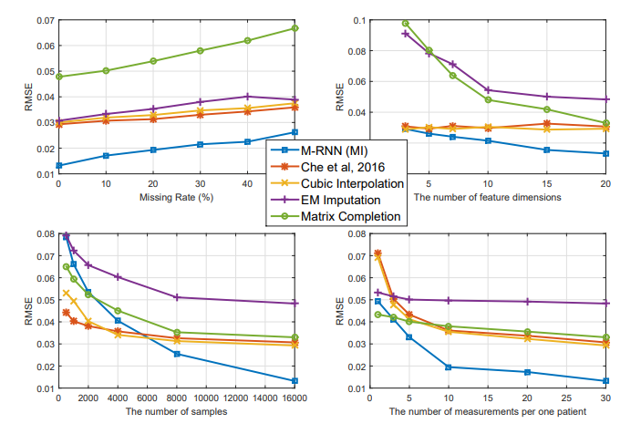
04
Results and Discussions
2. Additional Experiments
Source of Gain of M-RNN
Our dataset(25%)

Slide 16
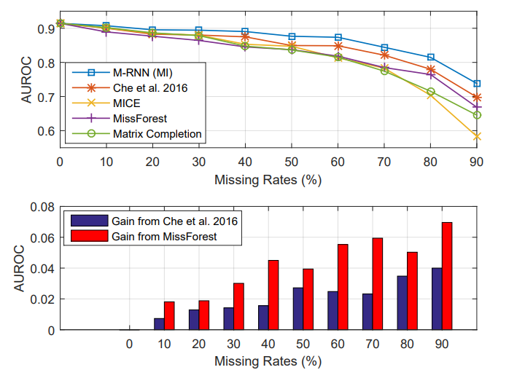
04
Results and Discussions
2. Additional Experiments
Prediction accuracy on the original datasets

Slide 17
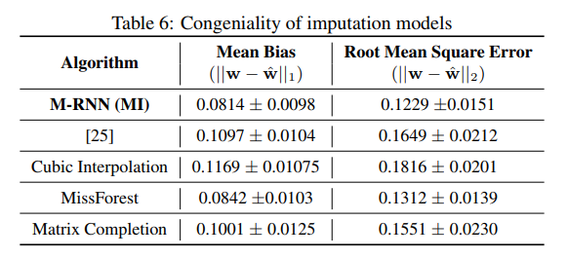
04
Results and Discussions
2. Additional Experiments
Congeniality of the model
Congeniality of an imputation model can be evaluated by specified metric.(mean bias, RMSE)
For comparison, we delete 20% of the data.
Result shows our methods is mor congenial than the benchmarks.

Slide 18
04
Results and Discussions
3. FIRM DATA
FIRM DATASET
Percentage of missing value - 20%
Dataset (132 rows, 14 feature)
PROMs(patients report outcome measurements :
FAC(보행/이동성), KOVAL(이동성), EQ5D(삶의 질), IADL(일상생활수행능력), FRAIL(노쇠 지수)
PBOMS(performance based outcome measurements) :
FIM(보행), MRMI(운동성), MBI(일상생활수행능력), BBS(낙상위험도), GDS(정동), MMSE(인지기능), HGS_R, HGS_L (악력)

Slide 19
04
Results and Discussions
3. FIRM DATA
FIRM DATASET
Congeniality of the FIRM data
23 patients with no missing values were randomly generated (20%)
Checked the difference between the generated data and the actual value through the model M-RNN
After that, we checked the performance of 132 people.

Slide 20
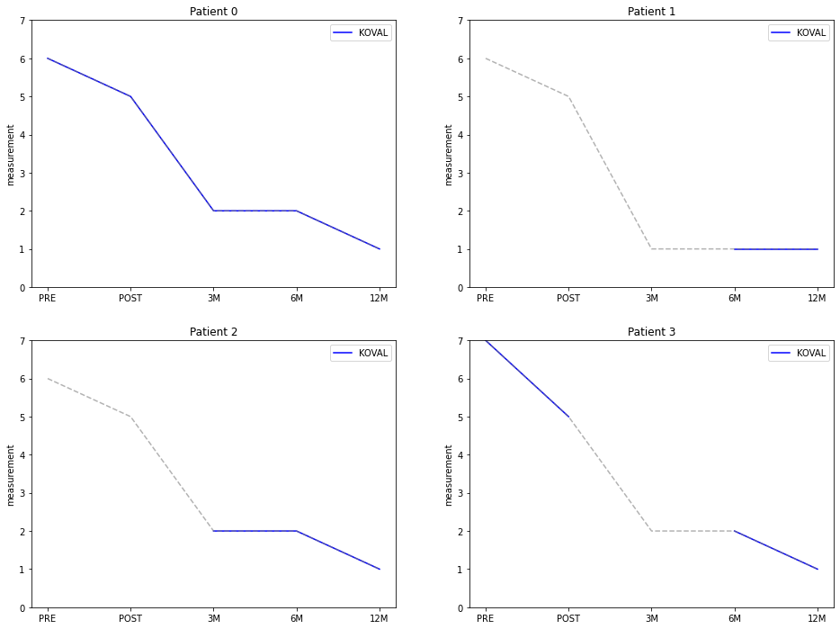
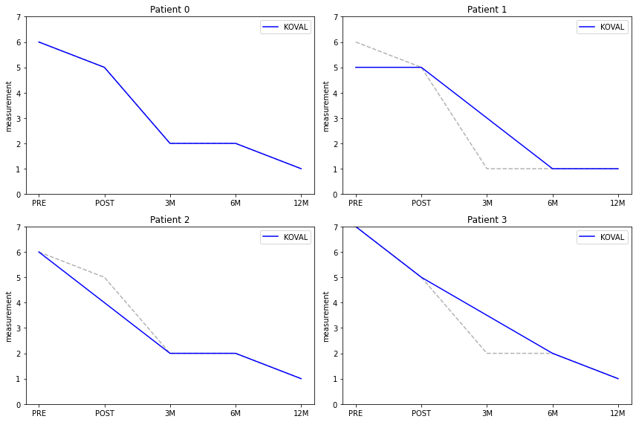
04
Results and Discussions
3. FIRM DATA
Congeniality of the FIRM data ( KOVAL )
Before
After

Slide 21
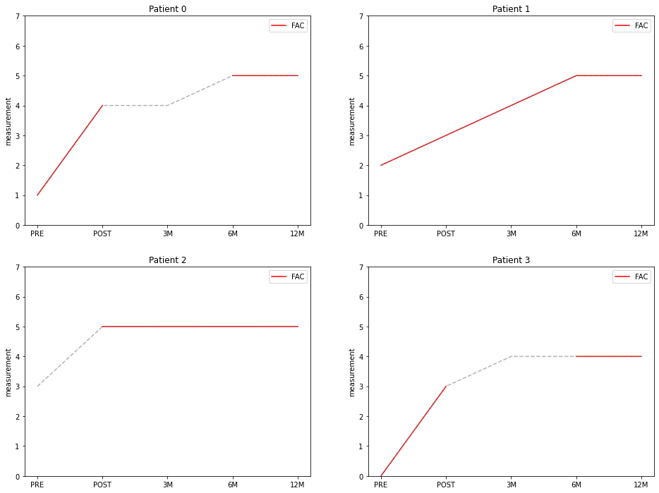
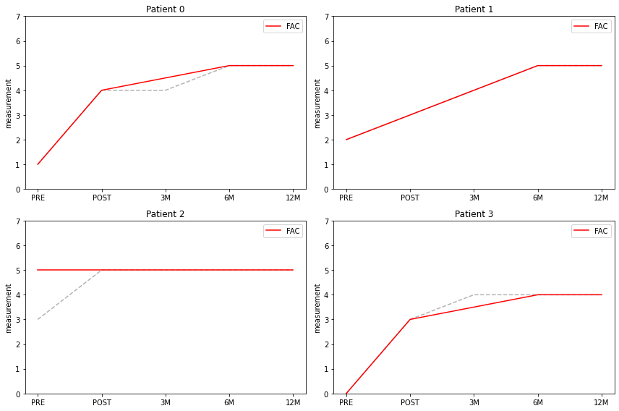
04
Results and Discussions
3. FIRM DATA
Congeniality of the FIRM data ( FAC )
Before
After

Slide 22
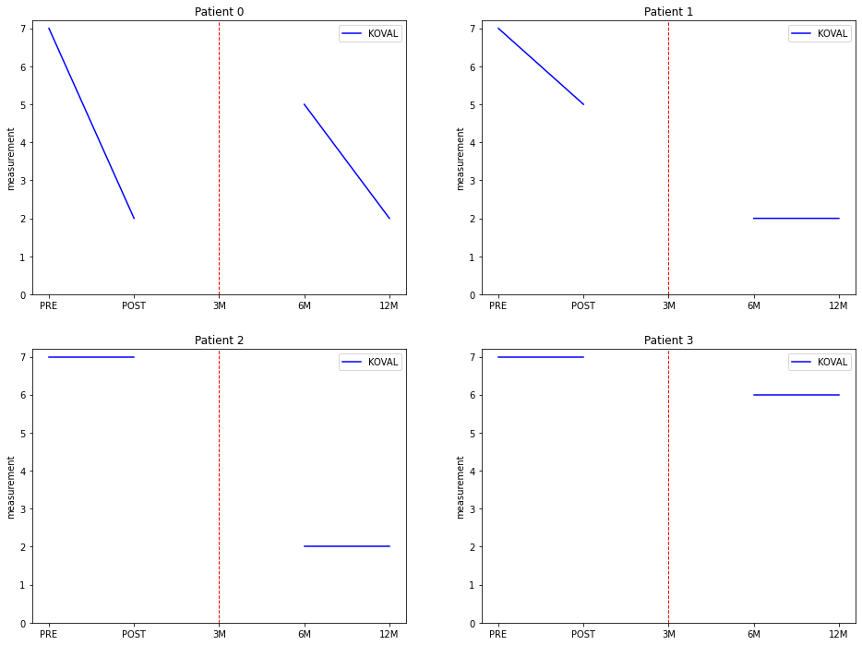
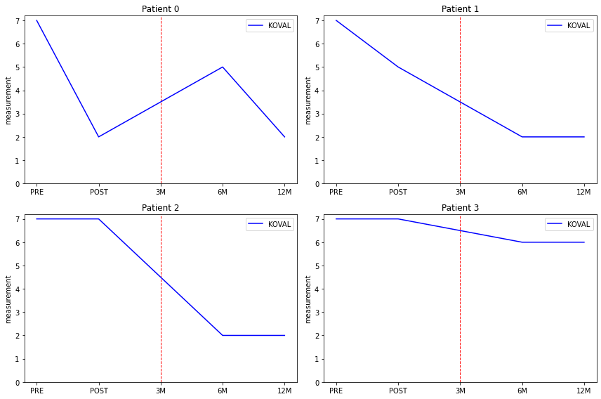
04
Results and Discussions
3. FIRM DATA
FRIM DATA(Using M-RNN)
Before
After

Slide 23
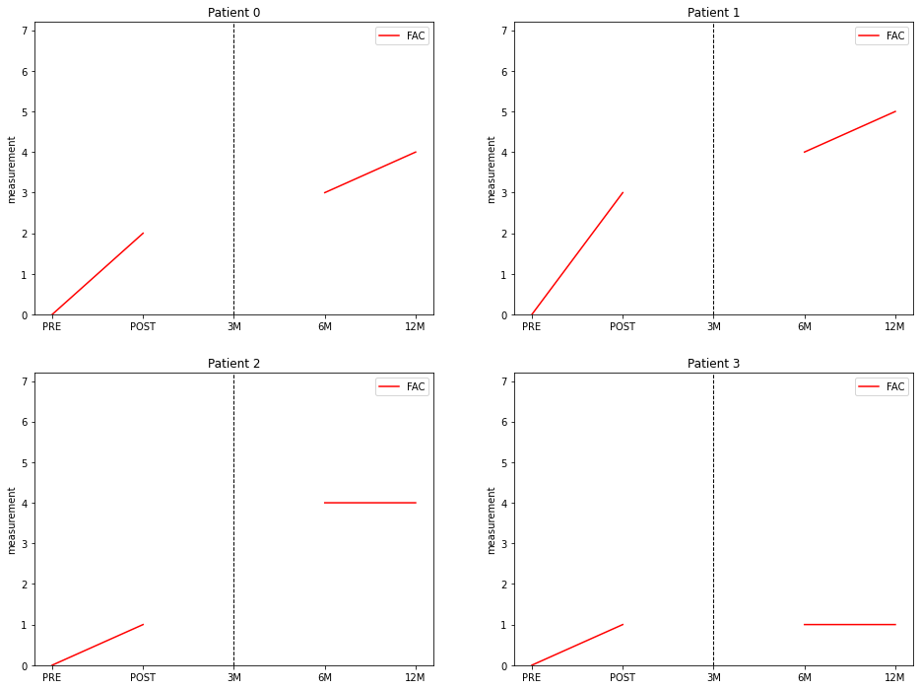
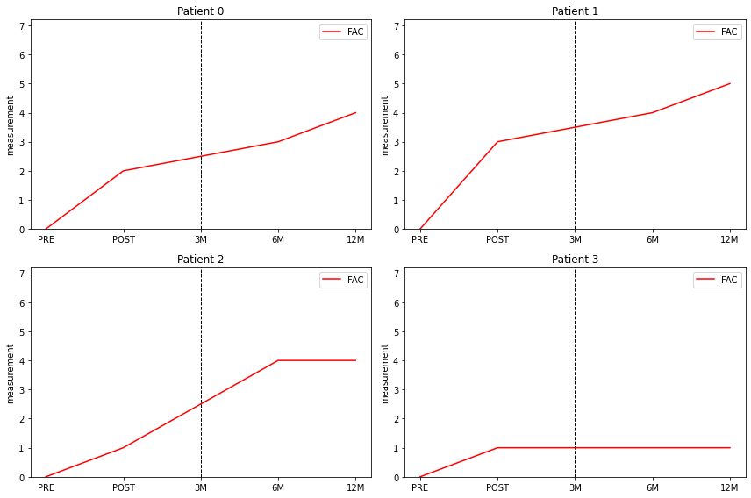
04
Results and Discussions
3. FIRM DATA
FRIM DATA(Using M-RNN)
Before
After

Slide 24
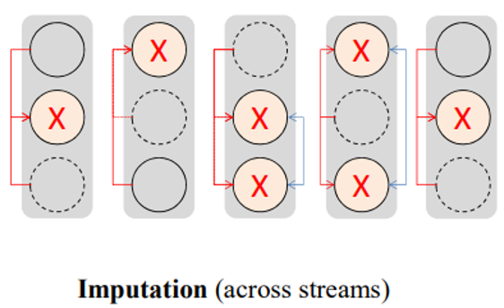
04
Results and Discussions
3. FIRM DATA
Additional study
Increase data accuracy by adding patient clinical characteristics (During Imputation Procedure)
Clinical Characteristics
NAME | age | height | ··· | edu | Blood test
DATA TYPE | Continuous | Continuous | ··· | Nominal | Continuous
Ex) | 80, 79 | 143, 160 | ··· | 1,2,3,4, | 1.12, 1.13

Slide 25
04
References
3. References
https://ieeexplore.ieee.org/abstract/document/8485748
https://www.kaggle.com/code/markwallbang/m-rnn-estimate-missing-values-in-time-series/notebook
https://github.com/jsyoon0823/MRNN

Slide 26
Q&A
감사합니다
billkim418@naver.com

